Slide 1
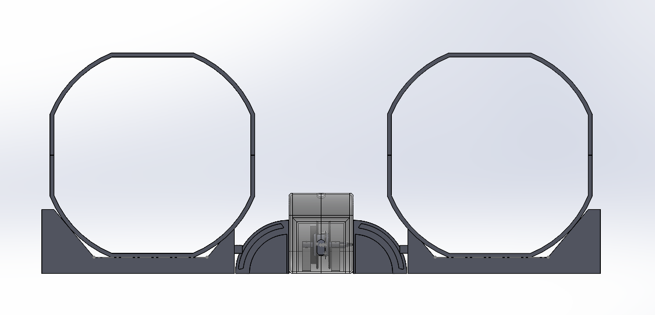
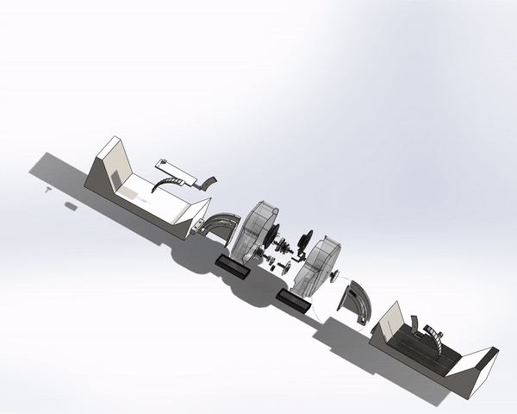
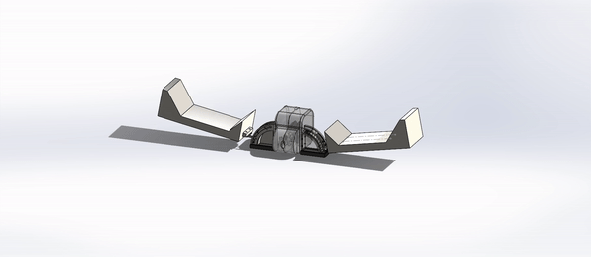

The Physio Assistant
Group E3.4
MCG2101

Slide 2
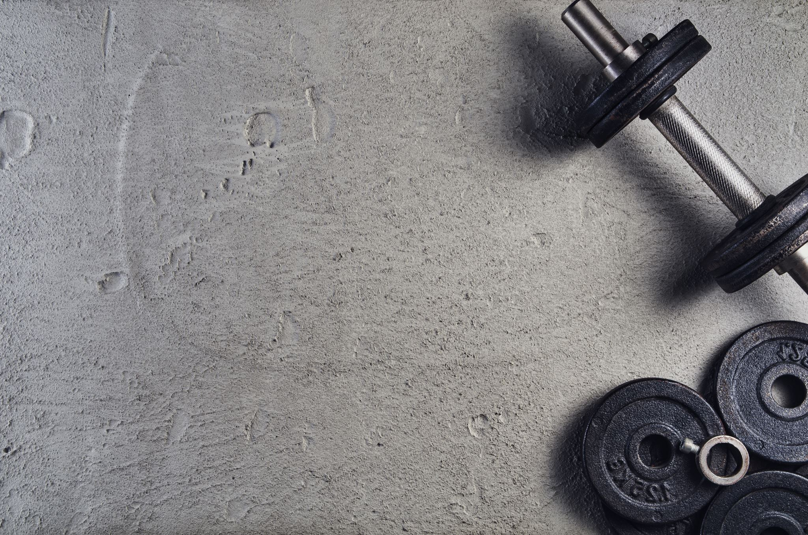
Project Goal and Mandate
The goal was to make a physio exercise device that could be rented to physio clients to aid with exercise form and exercise effectiveness.
It is a device that is meant to encourage completing a daily physio exercise regimen by facilitating proper form and maximizing effectiveness and recovery time.
The device should be safe, reliable, portable, lightweight and adjustable to fit the 98th percentile of body size and height for ages 14 and up.

Slide 3
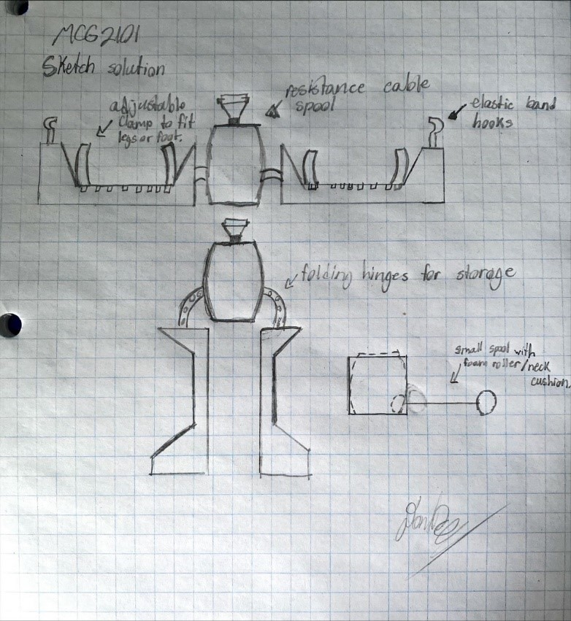
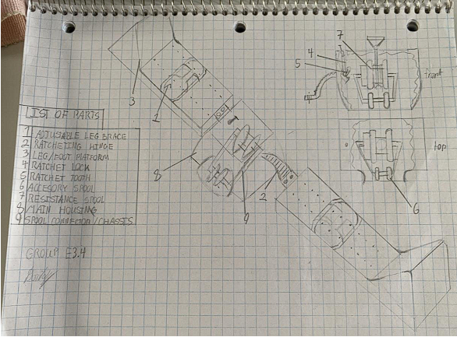
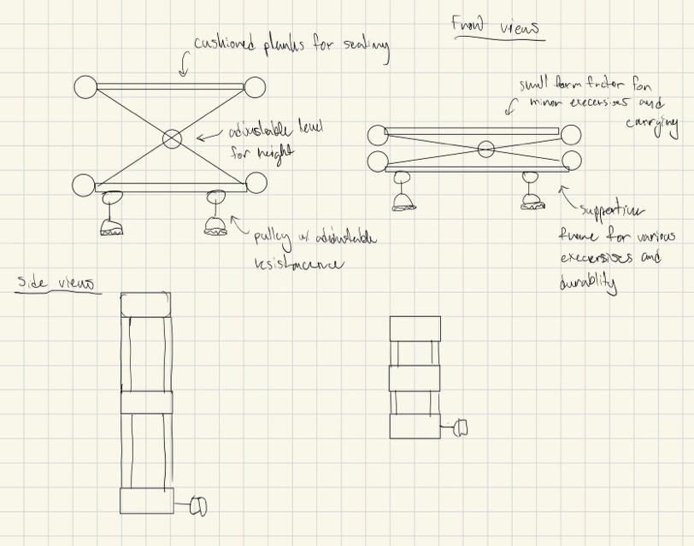
Methodology
Identifying criteria, restrictions and going through many different sketches and written solutions. We had come up and refined our design loop to continuously improve the design of each component along with their compatibility.
# | Criteria list | Importance | Value | Units
1 | Easy to carry and push/pull (Weight) | 0.105 HIGH | >5 | Kg
7 | The device is safe to use and has no potential hazards (safety) | 0.135 HIGH | >2 | Safety factor
8 | The device does not break (reliability) | 0.135 HIGH | >2 | Safety factor
9 | Varying levels of resistance (resistance level) | 0.12 HIGH | ≤30 | kg
12 | Combine with household objects | 0.045 | ≤2 | items
15 | Low setup time/assembly time | 0.045 | >5 | Minutes
16 | Cost of device | 0.09 | >200 | $(CAD)
17 | Stability and sturdiness when device is under load | 0.07 | >5 | Degrees of Tilt
18 | Ergonomic Design | 0.07 | None | N/A
19 | Combine with other physio equipment | 0.08 | <5 | Pieces of equipment
20 | Mechanism Durability | 0.105 HIGH | <10000 | Full Cycles of different parts

Slide 4
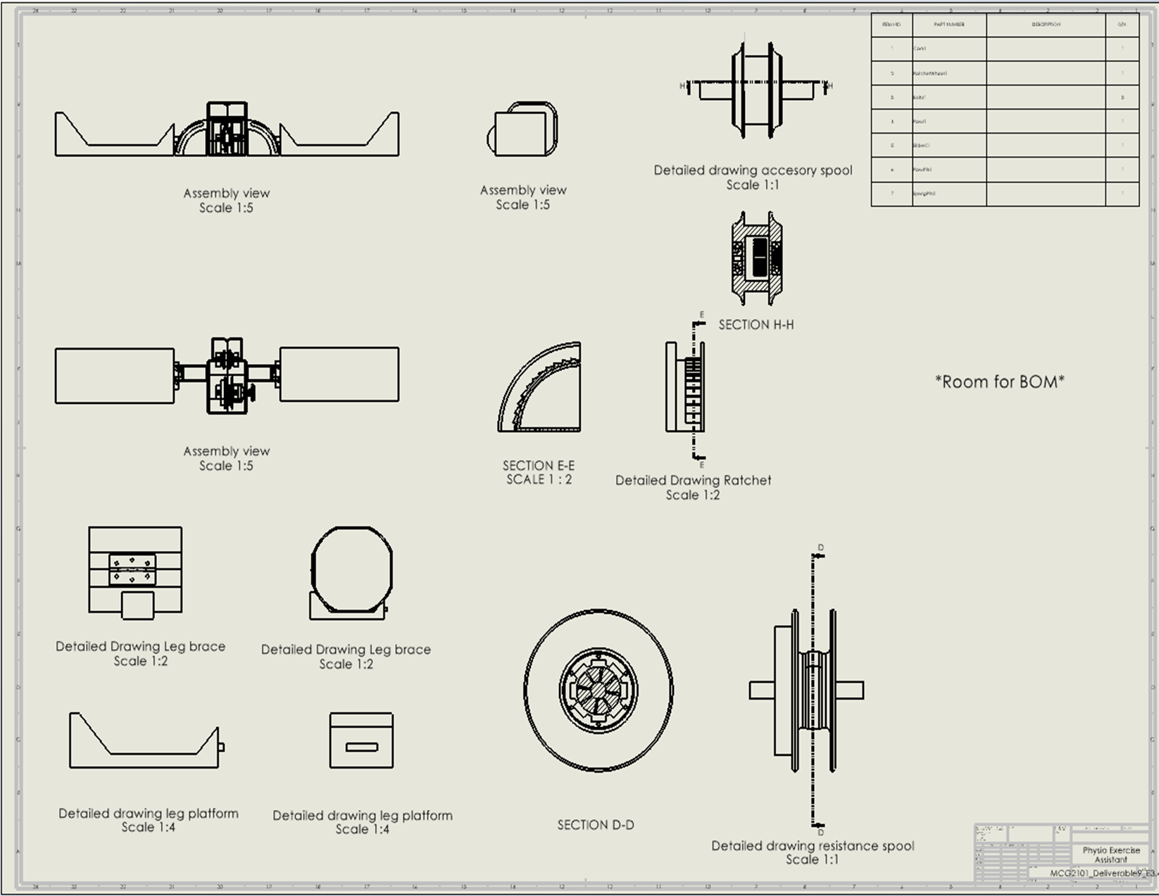
Design Overview

Slide 5
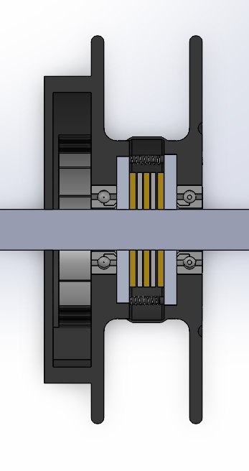
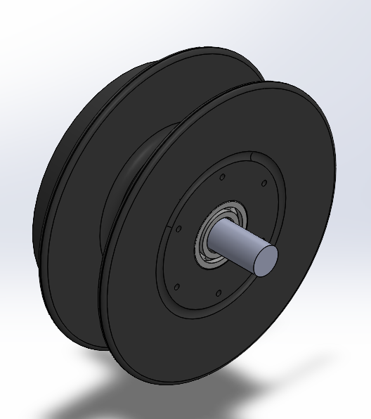
Subsystem (Resistance Spool)
Cable spool intended for resistance style workouts
The spool rides on plastic ball bearings on a fixed guide rod connected to the casing
Drum spring hooked onto guide rod to pull spool back to home position.

Slide 6
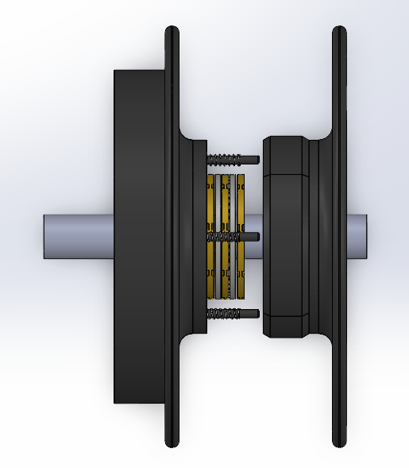
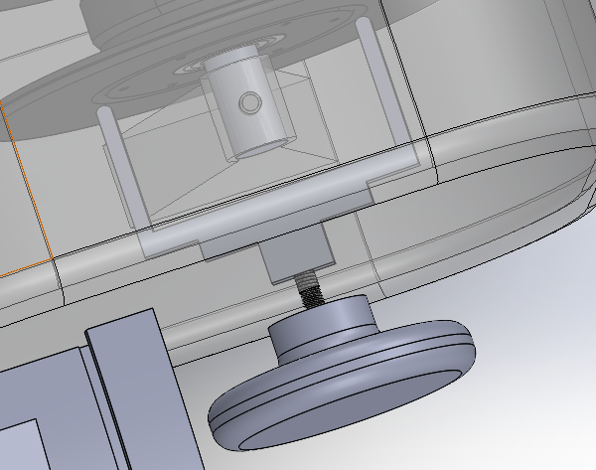
Subsystem (Resistance Spool)
Stationary friction discs create the desired load on cable and is adjusted via an adjustment fork.
Split spool design allows for compact packaging of subsystem

Slide 7

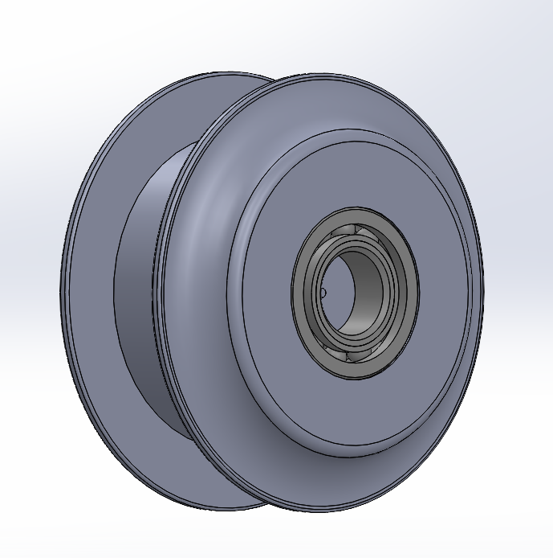
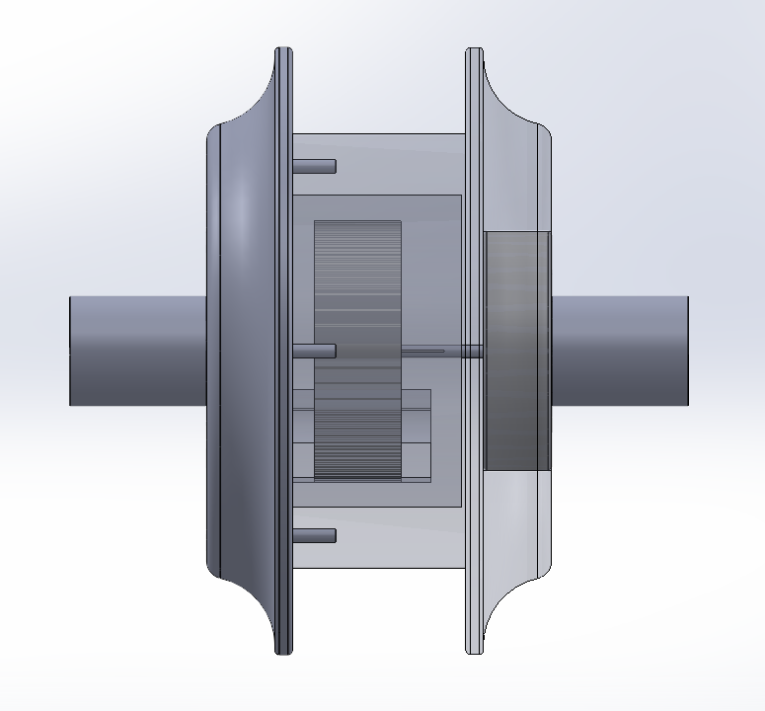
Subsystem (Accessory Spool)
Accessory spool is used to attach various handles and grips to a cable
The spool is sitting between two large guide rods, which are both fitted into two plastic ball bearings that are already fitted into the spool

Slide 8
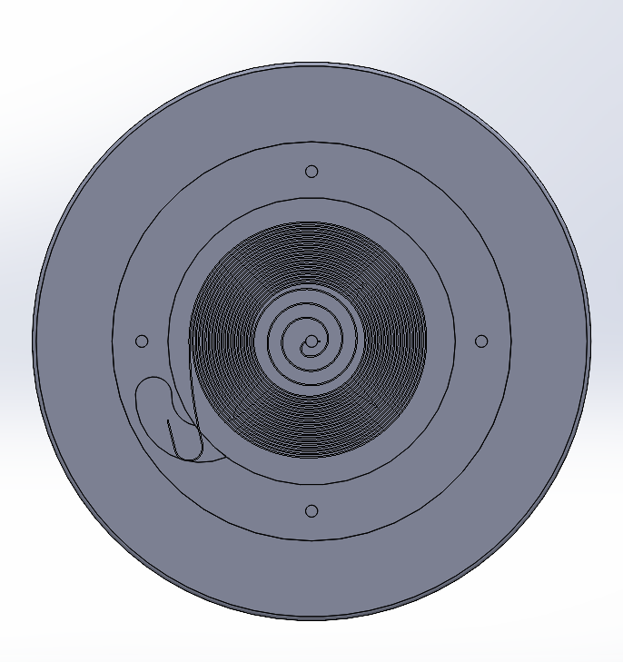
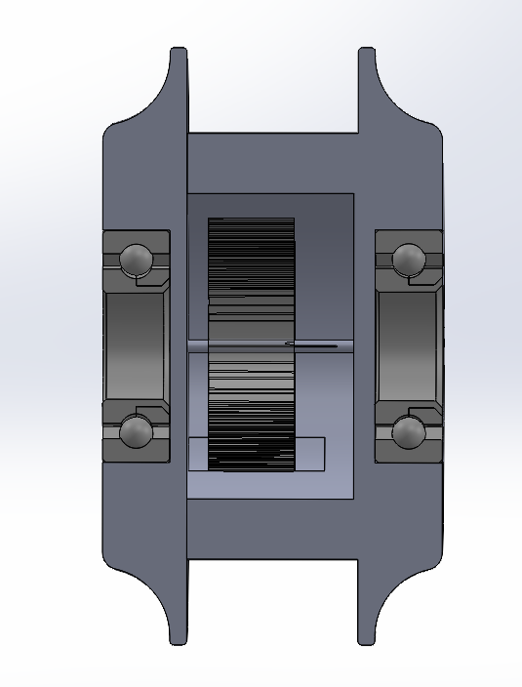
Subsystem (Accessory Spool)
The power spring is hooked on a small guide rod to pull the spool back into its home position
A cutout in the spool is made for the spring to hook onto, which creates tension once the spring is extended during rotation

Slide 9

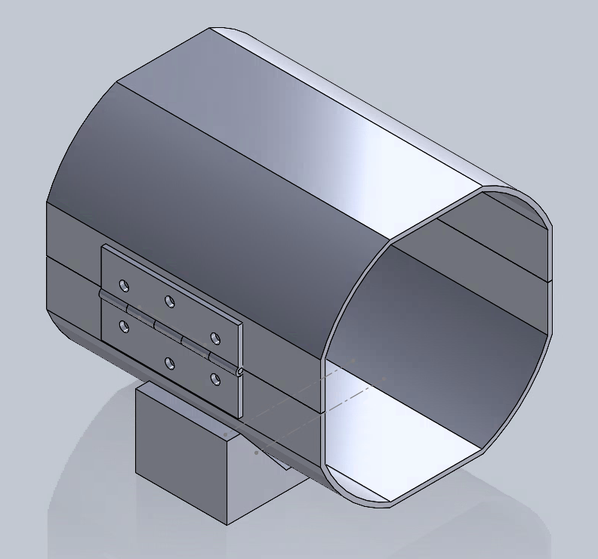
Subsystem (Leg Platform and Brace)
The hinge is fastened to the cylinder-shaped cast to allow the user to position his leg inside the brace
The leg platform on the bottom of the assembly holds the brace to the resistance device

Slide 10
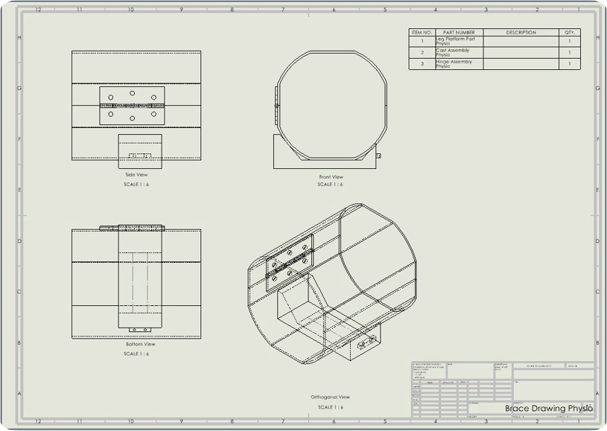
Subsystem (Leg Platform and Brace)
The cast is made up of two half cylinders to allow the patient to place his leg inside.
The half cylinders making up the cask are held together with a fastener attached to the leg platform

Slide 11
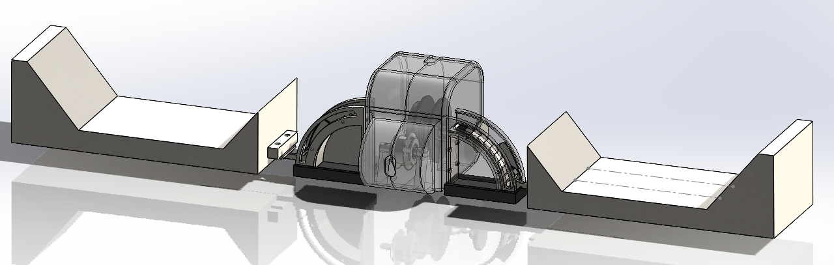
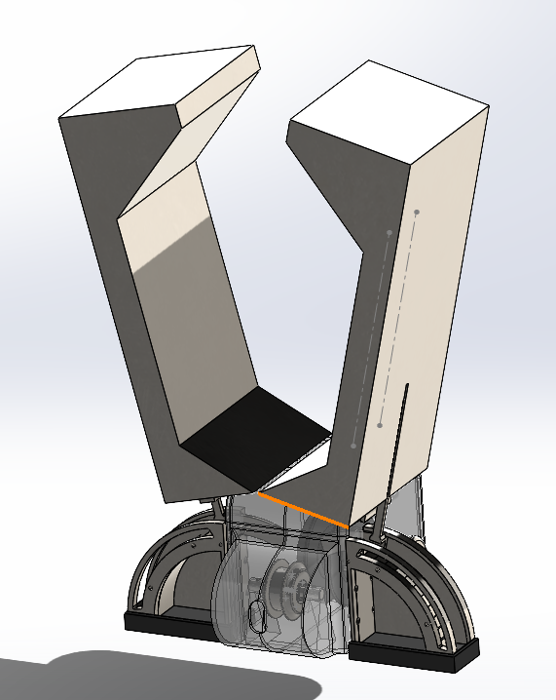
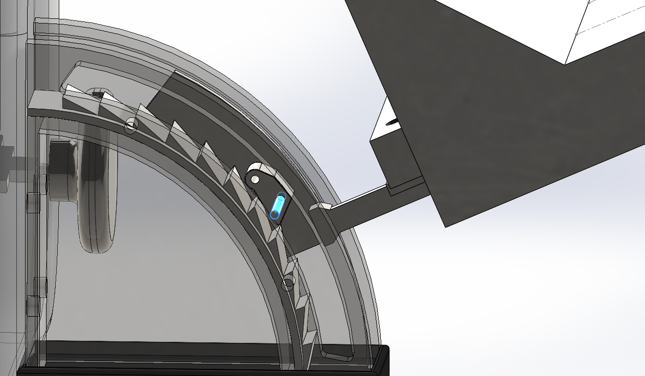
Subsystem (ratcheting hinge mechanism)
Enables finely-tuned adjustments for a variety of physical therapy exercises.
Sturdily constructed to hold up against repeated use while facilitating smooth motion.
Designed to lock securely, preventing unintended movement for user safety.

Slide 12
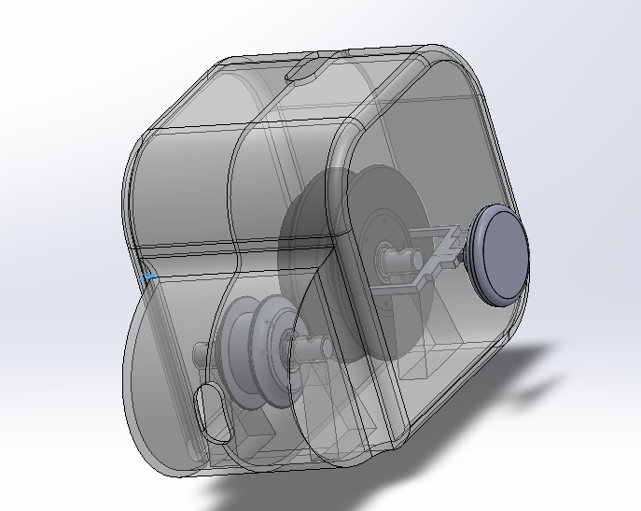
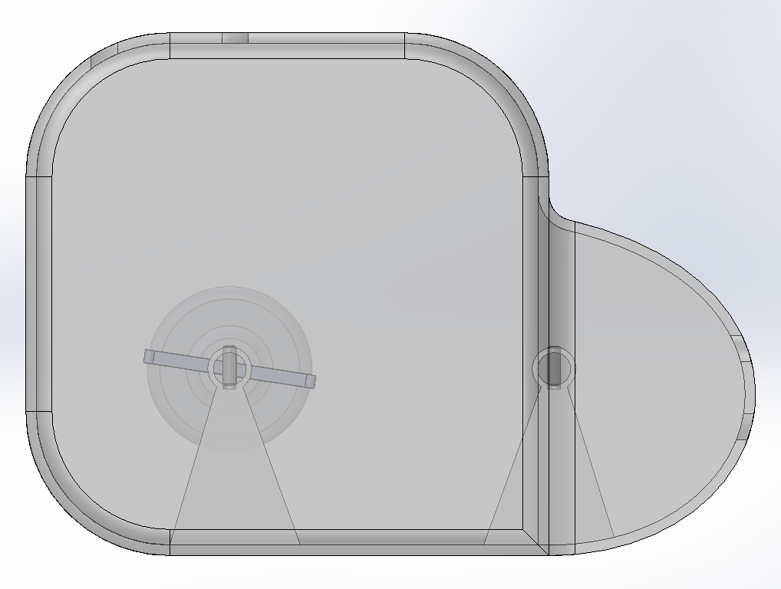
Subsystem (Spool casing)
Holds spool and hinge subassemblies together.
Both spools stationary rods hold together both halves of the casing as structural members of the casing.
Dowel pins are installed through the spool’s guide rods to secure casing and spools

